Slide 1
Programming Language II C#
Lecture – 6 Access Modifier

Slide 2
What is Assembly in C#
An assembly is a file that is automatically generated by the compiler upon successful compilation of every .NET application. It can be either a Dynamic Link Library(.dll) or an executable file(.exe).
Assembly contains Intermediate Language (IL) code
An assembly is a file (or files) that contains all deployment and version information for a program. Assemblies are fundamental
to the .NET environment.

Slide 3
What is namespace
A namespace is designed for providing a way to keep one set of names separate from another. The class names declared in one namespace does not conflict with the same class names declared in another.
A namespace defines a declarative region that provides a way to keep one set of names separate from another.

Slide 4
The using Keyword
using system;
Console.WriteLine ("Hello there");
System.Console.WriteLine("Hello there");

Slide 5
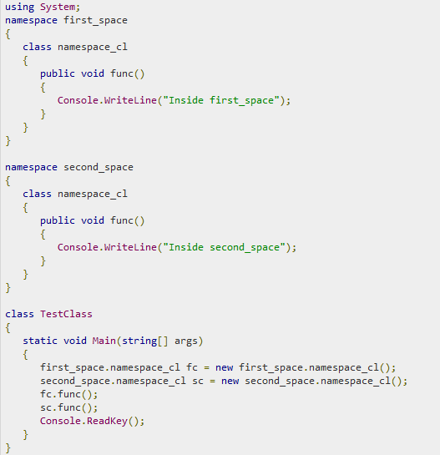

Slide 6
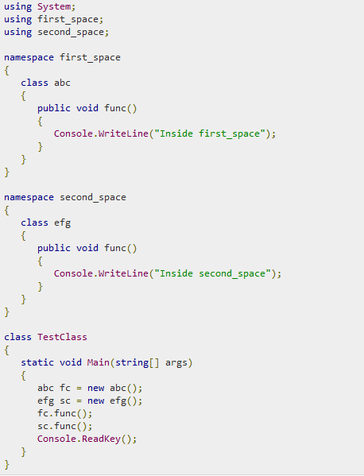

Slide 7
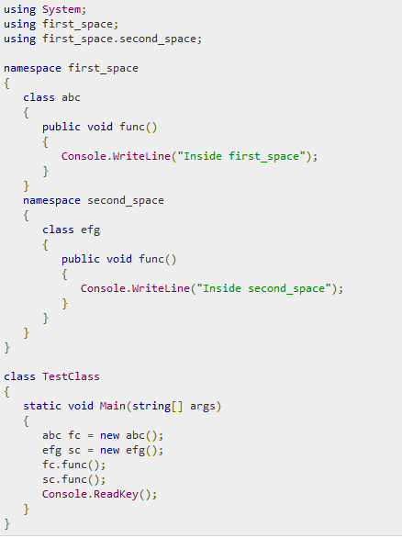

Slide 8
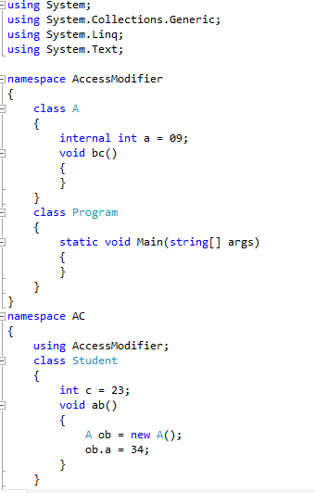

Slide 9
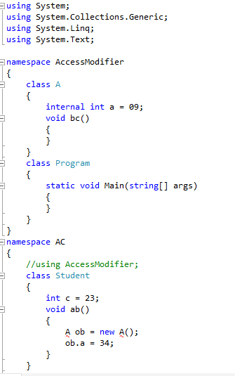

Slide 10
Namespaces Prevent Name Conflicts
The key point about a namespace is that names declared within it won’t conflict with
similar names declared outside of it. For example, the following program defines two
namespaces.

Slide 11
Projects in Visual Studio
When you create an app, application, website, Web App, script, plug-in, etc in Visual Studio, you start with a project. In a logical sense, a project contains of all the source code files, icons, images, data files and anything else that will be compiled into an executable program or web site, or else is needed in order to perform the compilation. A project also contains all the compiler settings and other configuration files that might be needed by various services or components that your program will communicate with.

Slide 12
Solutions in Visual Studio
A project is contained, in a logical sense and in the file system, within a solution, which may contain one or more projects, along with build information, Visual Studio window settings, and any miscellaneous files that aren't associated with any project.

Slide 13
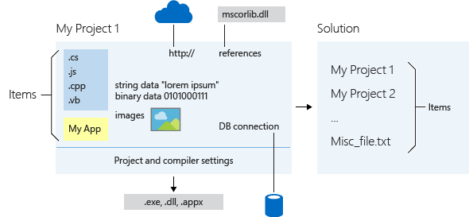

Slide 14
What are Access Modifiers in C#
Access modifiers are keywords used to specify the declared accessibility of a member or a type.

Slide 15
Why Access Modifiers
Access modifiers allow you to define who does or doesn't have access to certain features.

Slide 16
access specifier
An access specifier defines the scope and visibility of a class member. C# supports the following access specifiers:
Public
Private
Protected
Internal
Protected internal

Slide 17
Modifier | Description
public | There are no restrictions on accessing public members.
private | Access is limited to within the class definition. This is the default access modifier type if none is formally specified
protected | Access is limited to within the class definition and any class that inherits from the class
internal | Access is limited exclusively to classes defined within the current project assembly
protected internal | Access is limited to the current assembly and types derived from the containing class. All members in current project and all members in derived class can access the variables.

Slide 18
Public access specifier
allows a class to expose its member variables and member functions to other functions and objects. Any public member can be accessed from outside the class.

Slide 19
public
using System;
namespace RectangleApplication
{
class Rectangle
{
public double length;
public double width;
public double GetArea()
{
return length * width;
}
public void Display()
{
Console.WriteLine("Length: {0}", length);
Console.WriteLine("Width: {0}", width);
Console.WriteLine("Area: {0}", GetArea());
}
}
class Program
{
static void Main(string[] args)
{
Rectangle r = new Rectangle();
r.length = 4.5;
r.width = 3.5;
r.Display();
Console.ReadLine();
}
}
}

Slide 20
Private access specifier
allows a class to hide its member variables and member functions from other functions and objects. Only functions of the same class can access its private members. Even an instance of a class cannot access its private members.

Slide 21
private
namespace RectangleApplication
{
class Rectangle
{
private double length;
private double width;
double depth;
public void Acceptdetails()
{
Console.WriteLine("Enter Length: ");
length = Convert.ToDouble(Console.ReadLine());
Console.WriteLine("Enter Width: ");
width = Convert.ToDouble(Console.ReadLine());
}
public double GetArea()
{
return length * width;
}
public void Display()
{
Console.WriteLine("Length: {0}", length);
Console.WriteLine("Width: {0}", width);
Console.WriteLine("Area: {0}", GetArea());
}
}
class Program
{
static void Main(string[] args)
{
Rectangle r = new Rectangle();
r.length=34; //ERROR
r.depth=23; //ERROR
r.Acceptdetails();
r.Display();
Console.ReadLine();
}
}
}

Slide 22
Protected access specifier
allows a child class to access the member variables and member functions of its base class. This way it helps in implementing inheritance. We will discuss this in more details in the inheritance chapter.

Slide 23
Internal
using System;
namespace RectangleApplication
{
class Rectangle
{
internal double length;
internal double width;
double GetArea()
{
return length * width;
}
public void Display()
{
Console.WriteLine("Length: {0}", length);
Console.WriteLine("Width: {0}", width);
Console.WriteLine("Area: {0}", GetArea());
}
}//end class Rectangle
class ExecuteRectangle
{
static void Main(string[] args)
{
Rectangle r = new Rectangle();
r.length = 4.5;
r.width = 3.5;
r.Display();
Console.ReadLine();
}
}
}

Slide 24
protected internal access
allows a class to hide its member variables and member functions from other class objects and functions, except a child class within the same application. This is also used while implementing inheritance.

Slide 25
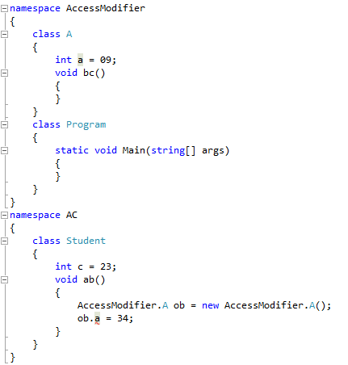

Slide 26
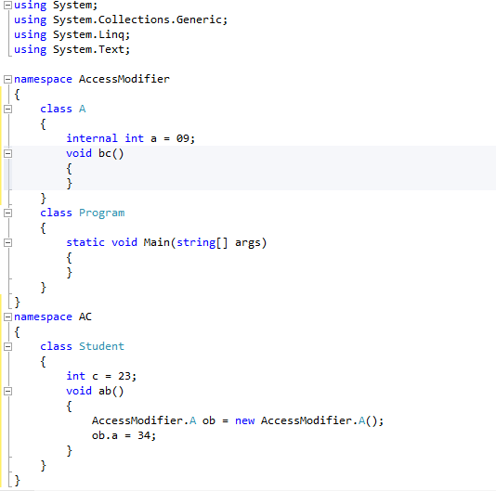

Slide 27
Why using static
There will be times when you will want to define a class member that will be used independently of any object of that class.
Normally, a class member must be accessed through an object of its class, but it is possible to create a member that can be used by itself, without reference to a specific instance.
To create such a member, precede its declaration with the keyword static. When a member is declared static, it can be accessed before any objects of its class are created and without reference to any object. You can declare both methods and variables to be static

Slide 28
What is static modifier
Whenever you write a method or declare a variable, it doesn’t create instance in a memory until you create object of class. But if you declare any method or variable with static modifier, it directly create instance in a memory and acts globally. The static modifier doesn’t reference with any object.

Slide 29
Static class
A class can be declared static. There are two key features of a static class. First, no object of
a static class can be created. Second, a static class must contain only static members.

Slide 30
using System;
static class NumericFn {
static public double Reciprocal(double num) {
return 1/num;
}
static public double FracPart(double num) {
return num - (int) num;
}
static public bool IsEven(double num) {
return (num % 2) == 0 ? true : false;
}
static public bool IsOdd(double num) {
return !IsEven(num);
}
}
class StaticClassDemo {
static void Main() {
Console.WriteLine("Reciprocal of 5 is " +NumericFn.Reciprocal(5.0));
Console.WriteLine("Fractional part of 4.234 is " +NumericFn.FracPart(4.234));
if(NumericFn.IsEven(10))
Console.WriteLine("10 is even.");
if(NumericFn.IsOdd(5))
Console.WriteLine("5 is odd.");

Slide 31
A constructor can also be specified as static. A static constructor is typically used to
initialize features that apply to a class rather than an instance. Thus, it is used to initialize
aspects of a class before any objects of the class are created.

Slide 32
using System;
class Cons {
public static int alpha;
public int beta;
// A static constructor.
static Cons() {
alpha = 99;
Console.WriteLine("Inside static constructor.");
}
// An instance constructor.
public Cons() {
beta = 100;
Console.WriteLine("Inside instance constructor.");
}
}
class ConsDemo {
static void Main() {
Cons ob = new Cons();
Console.WriteLine("Cons.alpha: " + Cons.alpha);
Console.WriteLine("ob.beta: " + ob.beta);
}
}

Slide 33
The difference between a static method and a normal method is that the static method
can be called through its class name, without any instance of that class being created.

Slide 34
using System;
class StaticDemo {
// A static variable.
public static int Val = 100;
// A static method.
public static int ValDiv2() {
return Val/2;
}
}
class SDemo {
static void Main() {
Console.WriteLine("Initial value of StaticDemo.Val is "+ StaticDemo.Val);
StaticDemo.Val = 8;
Console.WriteLine("StaticDemo.Val is " + StaticDemo.Val);
Console.WriteLine("StaticDemo.ValDiv2(): " +
StaticDemo.ValDiv2());
}
}

Slide 35
A static method does not have a this reference. This is because a static method does not execute relative to any object.
A static method can directly call only other static methods of its class. It cannot directly call an instance method of its class. The reason is that instance methods operate on specific objects, but a static method is not called on an object. Thus, on what object would the instance method operate?
A similar restriction applies to static data. A static method can directly access only other static data defined by its class. It cannot operate on an instance variable of its class because there is no object to operate on.

Slide 36
class StaticError {
public int Denom = 3; // a normal instance variable
public static int Val = 1024; // a static variable
/* Error! Can't directly access a non-static variable
from within a static method. */
static int ValDivDenom() {
return Val/Denom; // won't compile!
}
}

Slide 37
using System;
class AnotherStaticError {
// A non-static method.
void NonStaticMeth() {
Console.WriteLine("Inside NonStaticMeth().");
}
/* Error! Can't directly call a non-static method
from within a static method. */
static void staticMeth() {
NonStaticMeth(); // won't compile
}
}

